Slide 1
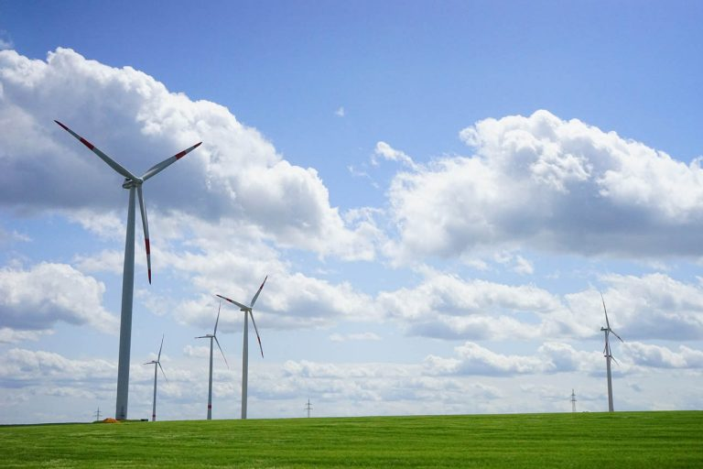
From Manual to Automated: A transition to automation supporting growth
Customer: ElectroRoute, a subsidiary of the A rated Mitsubishi Corporation, is a dynamic energy trading and trading services company headquartered in Dublin, Ireland
Industry: Financial Services
Size: 120 employees
Region: Europe, Asia
Products and services:
Microsoft PowerApps
Microsoft SQL Data Warehouse
Microsoft SQL Integration Services
IBM Cognos Analytics
"If you’re using excel for analytics, you’re missing a world of possibilities. We were stuck in a world of Excel for analytics and saw the opportunity to embrace Automation & Analytics”
—John Furlong, Chief Administration Officer, Electroroute
Situation
Solution
Outcome
Lots of man hours tied up in a reporting process which involved disparate queries and manually stitching data together in excel. We dispensed so much time and energy preparing data and we rarely had time analyze how to improve the performance of the business.
Partnering with ProStrategy we implemented Athena. Athena is the sub-ledger for all our trading activities importing volumes and price points from multiple sources capturing daily marks for all open trades. It is also our analytics engine for all trading performance with sophisticated views of open and closed positions.
Athena has enabled us to change the perception of finance within ElectroRoute. Previously we had struggled to provide business leaders with trusted and timely information. Today we are recognised as partners to be consulted to all major business decisions

Slide 2
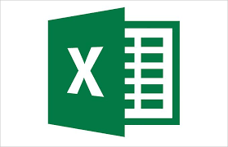
Data Sources
Transaction Processing
Trading Profitability App
Trading History
Service Performance
Trading Profitability App
Market Intelligence
Up to 20 data sources (internal & external) imported

